Slide 1


TENANT COORDINATION PROPOSAL
June 17, 2025
www.greeby.com

Slide 2

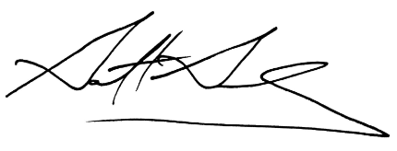

Thomas Rubio
VP, Redevelopment & Construction - West
Brixmor Property Group
1525 Faraday Avenue, #350
Carlsbad, CA 92008
Re: Tenant Coordination Services Proposal
Brixmor Property Group – West Coast Portfolio
Thomas:
The Greeby Companies, Inc. (Greeby), is pleased to submit a proposal to provide Tenant Coordination services on behalf of Brixmor Property Group.
Brixmor’s success hinges on timely, cost-effective tenant openings across a complex portfolio. Greeby’s proven Tenant Coordination model, refined over 40 years, delivers seamless communication, rigorous schedule control, and value-focused oversight. We act as a true extension of your team, ensuring smooth tenant delivery and consistent execution from lease to grand opening.
Greeby very much appreciates the opportunity to work with you and the Brixmor team.
Sincerely,
Garrett R. Greeby, CRX, CDP
President & CEO
The Greeby Companies, Inc.

Slide 3


THE GREEBY ADVANTAGE
611 Rockland Road, Ste. 106
Lake Bluff, IL 60044
(847) 604-8776
ON-TIME OPENINGS
— Delays cost money. We bring proven processes, schedule discipline, and oversight to get tenants open on time —
SEAMLESS TENANT DELIVERY
— Let your leasing and construction teams focus on what they do best. We coordinate tenants, architects, and contractors —
FEWER COSTY SURPRISES
— We flag issues early. We don’t just review drawings, we protect your budget and base building from the start —
A TRUE PARTNER
— We embed with your project team, stay accessible, and tailor our tools to your workflow. Consistency and responsiveness—
TRUSTED BY TOP DEVELOPERS
—Our track record includes successful partnerships with premier developers such as Simon, URW, Related, and more.—
The Shops at Columbus Circle
New York, NY

Slide 4
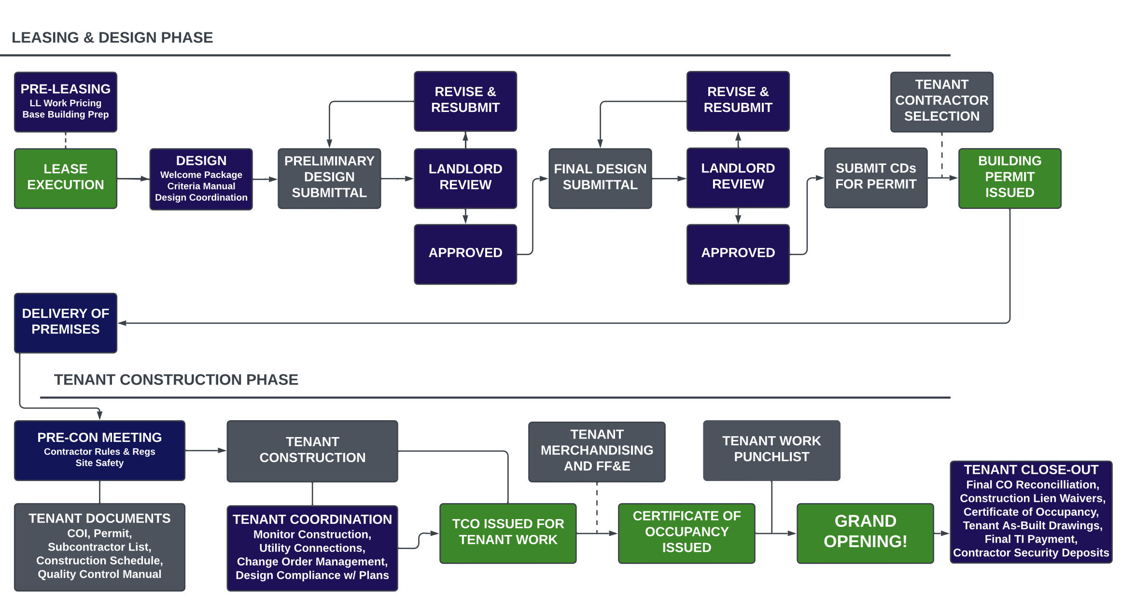

Slide 5
LEASING
SUPPORT
phase 1 – scope of services
Project Design Criteria
Landlord Work Estimates
Review existing Criteria Manual which outlines and governs all parameters, criteria rules, and regulations for retail Tenant design, permitting, and construction. The Criteria Manual should include architectural, storefront, signage, MEP, and Tenant plan submittal process information or as mutually determined in support of the retail property requirements.
Assist in the preparation of construction budget estimates in support of potential Client provided materials and labor that exceeds existing conditions. Solicit, confirm, and report to Client budget estimates for design and construction from Architects, Engineers, and General Contractors, as necessary for each project.
Lease Review
System Setup
Review lease language and exhibits to ensure conformance of each executed lease relative to Tenant and Client deliverables and timeframe.
Create and deploy Tenant space status tracking platform. Establish project-standard file architecture, information access protocols, and a reporting structure and deliverables.
Lease Abstract
Leasing Support
Prepare a lease summary abstract of key terms and provisions particularly for Tenant Coordination team use as it relates to design submittals guidelines, key dates, delivery of possession, and Landlord deliverables.
Support Client and Leasing during lease-up activities by providing input, feedback, and response to Tenant design and construction questions as well as industry standards.
Leasing Exhibit Review
Review and comment on proposed lease exhibit language for
Conformance with Criteria Manual and base building drawings.

Slide 6
DESIGN REVIEW
phase 2 – scope of services
Tenant Notification Package
Signage Review
In coordination with the Client, create project-standard Tenant Welcome Package for distribution to all Tenants and their design teams. The content of the package shall include the design criteria package, Lease Outline Drawings, Base Building Plans, and other relevant documents and information to facilitate Tenant design, approvals, and construction.
Receive and review signage plan shop drawings for design quality and conformity with all aspects of the Criteria Manual. Critique plans and make design suggestions where they fall short of requirements. Communicate the results of the plan review to the Tenant, their consultants, and the Client.
Municipality Communication
Design Coordination
Establish working relationship with the Tenant’s design team, the municipal Architectural Review Committee (if applicable), building department, and the municipal health department. Determine any/all idiosyncrasies and advise the Tenants accordingly.
Receive and answer inquiries from Tenant consultants concerning design criteria, construction, utilities available, routing of services, etc. Follow up with Tenant to ensure timely submission of plans (both preliminary and construction drawings), cut sheets, and material sample boards.
Plan Review
Receive and review Tenant plans for design quality and conformity with Criteria Manual. Critique plans and make design suggestions where they fall short of requirements. Communicate the results of the plan review back to Tenant and the Client.

Slide 7
LANDLORD
CONSTRUCTION
phase 3 – scope of services
Design Coordination
Permitting
Conduct periodic design review to assure that the goals and objectives of the Client are being met, verify constructability of the designed systems and coordinate the Owner-supplied systems.
Monitor the plan submission and approval process by the Client selected permit expeditor, architect or contractor to ensure timely submittal and review. Establish working relationship with the municipality Architectural Review Committee (if applicable) and building department, and the municipal health department to facilitate a timely review.
Team Selection
Assist the Client in the development, solicitation, negotiation, and award of all service contracts to include Architects, Specialty Consultants, Service Providers, and others pertinent to the approved project delivery method. All proposed services and associated fees will be reviewed and analyzed in writing for completeness, cost-effectiveness, feasibility, and market value.
Landlord Work
Establish and lead regularly scheduled construction progress meetings. Review construction progress for conformance with the project schedule and quality criteria. Maintain a central file of all construction documents. Review and evaluate all pricing associated with the change requests. Assist the Client in resolving any disputes that may arise between members of the project team that might impact the progress or cost of the work.
Value Engineering
In coordination with Client team, suggest alternate design solutions that achieve the Client’s functional requirements with the best balance between cost, performance, and reliability. Assist the Client in evaluating the benefits and disadvantages of all.
Space Turnover
Bid & Award
Assist Client in the notification and delivery of Tenant premises in accord with all lease terms. Conduct on-site walkthrough with Tenant representative and receive written confirmation of Premises acceptance.
Assist Client in soliciting and pre-qualifying equipment subcontractor candidates and suppliers. Assist in the preparation of bidding requirements and bid documents.

Slide 8
TENANT
IMPROVEMENT
phase 4 – scope of services
Premises Acceptance
Tenant Construction Oversight
Conduct on-site walkthrough with Tenant representative and receive written confirmation of Premises acceptance.
Monitor on-site Tenant construction to ensure conformity with the approved plans, Criteria Manual, and the Contractor Rules & Regulations. Ensure that all work is being carried out in a safe and professional manner.
Contractor Check-In
Establish “check in” procedures for Tenant contractors and hold pre-construction meeting prior to allowing the commencement of any Tenant work.
Field Coordination
Acting as Client liaison, coordinate Tenant’s fit-out with Ownership, base building development, design and construction, property management, and operations team to minimize disruption to existing and/or adjacent Tenants, residents, neighbors, and the general public.
Rules & Regulations
Distribute, review, and enforce all contractor rules and regulation sections of the Criteria Manual for the project with Tenant and its contractor to ensure understanding and acceptance.
Merchandising
Deposits & Fees
Ensure that all approvals needed for stocking of merchandise are properly secured by Tenant. Facilitate and coordinate Tenant delivery, unloading and stocking of merchandise with center operations, neighboring Tenants, and base building operations.
Receive all required paperwork submittals, construction deposit checks, fees, and certificates of insurance and forward to Client representative.
Permit Processing
Occupancy
Monitor and facilitate the Tenant’s timely submittal of construction drawings for permit, municipality review, and comment and receipt of Tenant’s building permit for interior fit-out.
Ensure all municipal and Landlord approvals needed for store opening have been received by or on behalf of the Tenant.

Slide 9
phase 5 – scope of services
CLOSE-OUT
Punchlist
Warranties
Carry out a store walkthrough immediately prior to store opening and prepare a list of delinquent items.
Where applicable, receive copies of all product warranties and guarantees for major systems, equipment, and finishes used in Tenant fit-out.
Lien Waivers
Receive a copy of the Tenant contractor’s final unconditional waiver of lien for the project which shall also include a schedule of values for project fit-out cost.
TI Reconciliation
Review project close-out documentation and upon satisfactory submission of such, recommend release of Tenant Improvement and/or inducements, if applicable.
Certificate of Occupancy
Receive a copy of the Tenant’s municipal approval to operate and, if required, work to receive the final Certificate of Occupancy from the Tenant for the Premises.
Security Deposits
Upon satisfactory completion of project punchlist and after all base building damage and repair has been reconciled with each Tenant’s contractor, assist in the tracking of all security deposit balance release to each Tenant contractor.
As-Built Drawings
Receive the Tenant “as-built” drawings in electronic format and provide them to the Owner.

Slide 10
FEE MATRIX – TENANT COORDINATION
PROFESSIONAL SERVICES
Trish Beckman - Senior Project Manager:
$21,500.00/mo
Mark Altamirano - Project Manager:
$20,000.00/mo
HYBRID: HOME & CORPORATE OFFICE
$1,750.00/mo
Greeby Executive Oversight:
PROJECT FEES
$4,000.00
Project Set-Up*:
Project & Travel Expenses:
At-Cost
*Project Set-Up: One-Time Payment
Additional Services
Any additional services requested by the Client in writing, not included in Scope of Services, will be provided on an hourly basis at the following rates:
Executive Team Rate: $225.00/hour
Tenant Coordinator: $185.00/hour
Administrative Services: $80.00/hour

Slide 11
PROJECT FEES
Project Start-Up
A one-time payment of four thousand dollars ($4,000.00) will be made upon execution of this agreement for Project Set-up. Payment is due within ten (10) business days of execution of this agreement.
Project & Travel Expenses
Reimbursement from Client subject to the provision of proper documentation for the following project-related expenses at cost:
Project-related, out-of-pocket expenses incurred in the conduct and support of business away from home office as requested by Client. Such expenses shall include, but not be limited to, airfare, mileage, lodging, meals, parking, etc.
Administrative expenses incurred in connection with work performed on Client’s behalf and to handle project-related documents during the course of said project. Expenses shall include, but not be limited to, costs for external Internet, reproduction, photocopies, printing, postage, and overnight delivery.
Project-related information technology systems other than Microsoft Word, Microsoft Excel, Microsoft Project, Adobe Acrobat, DWG file reader, email client, web browser, and standard image viewer, including various personal computer and web-based project, scheduling, cost and information management systems, and hosting for the purposes of collaboration, document sharing, project tracking, and reporting.
Any additional expenses incurred during production of services, agreed to by Client in writing in advance.

Slide 12
CLARIFICATIONS & EXPECTATIONS
A. Municipality Approval
E. Team Assembly
Client shall be responsible for preparing, presenting and securing all development and master criteria municipality approvals. If requested, Greeby can prepare architectural review committee / design review board exhibits, support materials and presentations as an additional service.
Client shall be responsible for prequalifying, soliciting, preparing of bid packages, scoping, negotiating and contracting all consultants including but not limited to designers, architects, specialty consultants, contractors, and vendors. Greeby shall coordinate with all Client selected team members as required to deliver its services and as mutually agreed.
B. Lease Plan / LODs / Lease Exhibits
The lease and/or merchandising plan(s) will be prepared and maintained by Client or its consultants and will be available to Greeby for download, review and comment. Client or its consultants will create and provide the Lease Outline Diagrams (LOD) in electronic format (.pdf and .dwg) to Greeby for download, review, comment, and distribution as required. Client or its consultants will prepare all required lease exhibits.
F. On-Site Conditions
If Greeby staff is required to work on-site, Client shall be responsible to provide access to the following, if available:
High speed Wi-Fi internet access
Access to conference room or management office
Adequate power and lighting
Restroom facilities
Potable water
C. Tenant Status Report (TSR)
Greeby shall create and maintain a cloud-based TSR (Status Plan) to track Tenant key milestone dates, progress and other information as mutually agreed to facilitate retail space delivery.
D. Executed Leases
Greeby shall be provided a copy of all executed Tenant leases in their entirety for review and comprehension of all Landlord lease obligations.

Slide 13
TERMS & CONDITIONS
A. Initial Retainer
employees’ or agents’ negligent or willful acts or omissions under this Agreement. Greeby agrees to indemnify and hold harmless Client, its officers, employees or agents against and in respect of, any and all damages, claims, losses, liabilities and expenses, including without limitation reasonable attorney’s fees, which may be imposed upon, incurred by or asserted against Client, its officers, employees or agents to the extent arising out of or resulting from Greeby’s, its officers’, employees’ or agents’ negligent or willful acts or omissions under this Agreement. The foregoing provisions shall survive the termination of this Agreement.
An initial retainer of four thousand dollars ($4,000.00) will be made upon execution of this agreement for ‘Project Startup.’ Upon receipt, services shall commence, with duration of services and/or delivery dates being adjusted accordingly.
B. Invoicing & Payment
Greeby will invoice Client for services rendered on the last day of every month for work completed that month, with payment due within 25 days of the invoice date. Accounts unpaid 25 days after the invoice date will be subject to a service charge of 2.5% on the then unpaid balance, and additionally every 30 days thereafter. In the event any portion or all of an account remains unpaid 60 days after billing, Client shall pay all costs of collection, including, but not limited to, reasonable attorney’s fees.
Client agrees to send all payments via wire/ACH or overnight via a shipping company (FedEx, UPS, etc.), NOT via the USPS.
D. Additional Insurance
Anything in this Agreement to the contrary notwithstanding, Client understands and agrees that Greeby is not required to purchase or maintain any other insurance unless Client shall purchase or reimburse Greeby for the cost of same and such can be obtained.
C. Hold Harmless
E. Diligence/Termination
$3,000.00
Client agrees to indemnify and hold harmless Greeby, its officers, employees or agents against and in respect of, any and all damages, claims, losses, liabilities and expenses, including without limitation reasonable attorney’s fees, which may be imposed upon, incurred by or asserted against Greeby, its officers, employees or agents to the extent arising out of or resulting from Client’s, its officers’,
Greeby agrees that it shall use its best efforts, skill, experience and judgment to perform the services specified in this Agreement, diligently and conscientiously performing its duties thereunder, subject to any delays caused by the Client or by strikes, lock-outs, acts of God, or other reasons beyond Greeby’s control.

Slide 14
TERMS & CONDITIONS
This Agreement may be terminated by either party with or without cause upon thirty (30) days written notice. In the event of termination, Greeby shall be paid the compensation for services performed to termination date, including any reimbursable expenses that may be due.
H. Additional Insured
Client shall purchase or self-insure and maintain insurance (or require the General Contractor to purchase and maintain insurance) to protect Client and name Greeby as an additional insured from claims of third parties for damages because of bodily injury or property damage occurring during construction on site subject to the provisions herein. Evidence of said coverage will be provided Greeby by Client prior to the start of construction. The policy limits for insurance required to be carried by Client or General Contractor hereunder shall be at least equal to the limits and shall contain types of coverage customary for projects similar to the project contemplated herein. Client and Greeby hereby agree to waive all rights against each other and each other’s respective employees and officers for damage caused by fire or other perils to the extent covered by property insurance obtained by Client, General Contractor or any other person relating to the project covered hereby, and each party’s liability insurance policy shall provide for waiver of subrogation by endorsement or otherwise.
F. Records
Greeby shall keep or cause to be kept during the term of this Agreement records as may be necessary to accurately indicate all of the business they transact pursuant to this Agreement. All such records shall be open during normal business hours for inspection and examination by the Client with five (5) day written notice and may be audited by the Client at Client’s expense.
G. Construction Cost / Means & Methods
During construction, Greeby shall not be responsible for material or labor selection, availability or pricing fluctuations, construction means, methods, techniques, sequences and procedures employed by contractors and consultants in performance of their contracts and shall not be responsible for the failure of any contractors or consultants to carry out the work in accordance with their contract and/or contract documents, or applicable standards of safety.
I. Advancement of Funds
It is specifically understood that Greeby shall not be required at any time to advance its own funds for the payment of any bills for labor, material, or services furnished to the project.
$1,250.00

Slide 15
TERMS & CONDITIONS
J. Equal Opportunity
Owner’s attorney or other consultants, and that Greeby is performing only technical support and/or advisory services as set forth in this contract. Any drawings, sketches, or graphic representations shall be for conceptual representation only and shall not be construed or used for permitting or construction. Any approval by Greeby of any plans and specifications for the project or any part thereof, or of construction of the project or any part thereof, shall impose no responsibility, obligations or liability upon Greeby or any of its officers or employees to the Client for defects in the plans, specifications or construction.
Greeby represents that it is now and shall at all times during this contract continue to be an Equal Opportunity Employer and shall conform to all applicable Equal Opportunity Laws, Executive Orders, Rules and Regulations. Greeby will comply with the Immigration Reform and Control Act of 1986. If requested by Client, Greeby will certify or attest in writing within thirty (30) days of Client’s request that no services subject to this Agreement are or will be performed by unauthorized aliens.
K. Independent Contractor
M. Notices
The Client and Greeby agree the relationship of Greeby to the Client is that of independent contractor and that Greeby and the Client shall not be deemed to have any other relationship with regard to any services to be performed by Greeby for the project. Greeby and the Client shall not be deemed to be partners, joint venturers, or principal and agent, and Greeby shall have no authority to bind the Client to any obligation to any third party, or to execute any agreements or contracts on behalf of the Client
Any notices or communications required or permitted to be given or made hereunder shall be deemed to be so given or made when in writing and delivered in person or sent by United States registered or certified mail, postage prepaid, directed to the parties at the following addresses or such other addresses as they may from time to time designate in writing. Said notices or communications shall be effective upon receipt.
L. Limit of Responsibility
Client: Brixmor Property Group
1525 Faraday Avenue, #350
Carlsbad, CA 92008
Attn: Thomas Rubio
Greeby: The Greeby Companies, Inc.
4026 N Maplewood Avenue, #100 Chicago, IL 60618
Attn: Garrett Greeby
It is further understood that Greeby is not assuming the responsibilities of the Architect, Engineers, Contractor or Contractors, Client, Owner, Client or Owner’s broker, Client or

Slide 16
TERMS & CONDITIONS
N. Effective Date
R. Display
This agreement becomes effective only when signed by agents of Client and Greeby. Regardless of the place of signing of this agreement, Client agrees that for purposes of venue, this contract was entered into in Illinois and any dispute will be litigated or arbitrated in Lake County, Illinois.
Greeby retains the right to display graphics and other design elements as examples of work in their portfolio and as content features in other projects.
S. Instruments of Service
O. Sole Agreement
All documents, prepared by Greeby, its Associates, and consultants are Instruments of Service for use solely with respect to this Project. This includes documents in electronic form. Greeby shall be deemed the authors and owners of their respective Instruments of Service whether produced by Greeby, its Associates, or and its consultants and shall retain all common law, statutory and other reserved rights, including copyrights. The Instruments of Service shall not be used by the Client or any other party for future additions or alterations to this Project or for other projects, without the prior written agreement of Greeby. Any modifications to or unauthorized use of the Instruments of Service shall not be permissible.
The agreement contained in this contract constitutes the sole agreement between Client and Greeby regarding all items included in this agreement.
P. Assignment
Client shall not voluntarily or by operation of law assign, license, or transfer any part or all of its interest in this Agreement without Greeby’s prior written consent. Any assignment, license, encumbrance, or transfer of this Agreement without Greeby’s consent shall be void and shall constitute a material default.
Q. Permission
T. Staffing
Greeby assumes Client has permission to use any images or design elements that are provided by Client for any services as outline above, and will hold harmless, protect, and defend Greeby from any claim or suit arising from the use of such elements.
Greeby shall appoint project staff to perform or directly oversee all services to be performed by Greeby under this Agreement. Project staff may report directly to and consult with the Client on a regular basis satisfactory to Client during all phases of said project as

Slide 17
TERMS & CONDITIONS
outlined in the Agreement. If for any reasons any staff member is unable to perform the services to be provided herein for any period, Greeby shall provide an individual or individuals acceptable to perform the duties outlined herein.
U. Conversion Fee
If the Client or any of its affiliates should wish to hire an employee, Associate or consultant of Greeby to work on the above mentioned or any other project during or within six (6) months after the duration of this contract, the Client shall pay Greeby a conversion fee equal to $50,000.00, which reflects our investment in staff training and continuity. Said fee shall be invoiced the day the Greeby employee, Associate, or consultant announces his or her resignation from the Greeby team and shall be paid in full by Client twenty (20) days thereafter.
V. Qualifications
Greeby hereby represents that it is a sophisticated real estate consultancy firm, with experience in connection with projects similar in scope and complexity to the project contemplated hereby and with experience in performing the services and obligations required to be performed by Greeby under this Agreement.

Slide 18
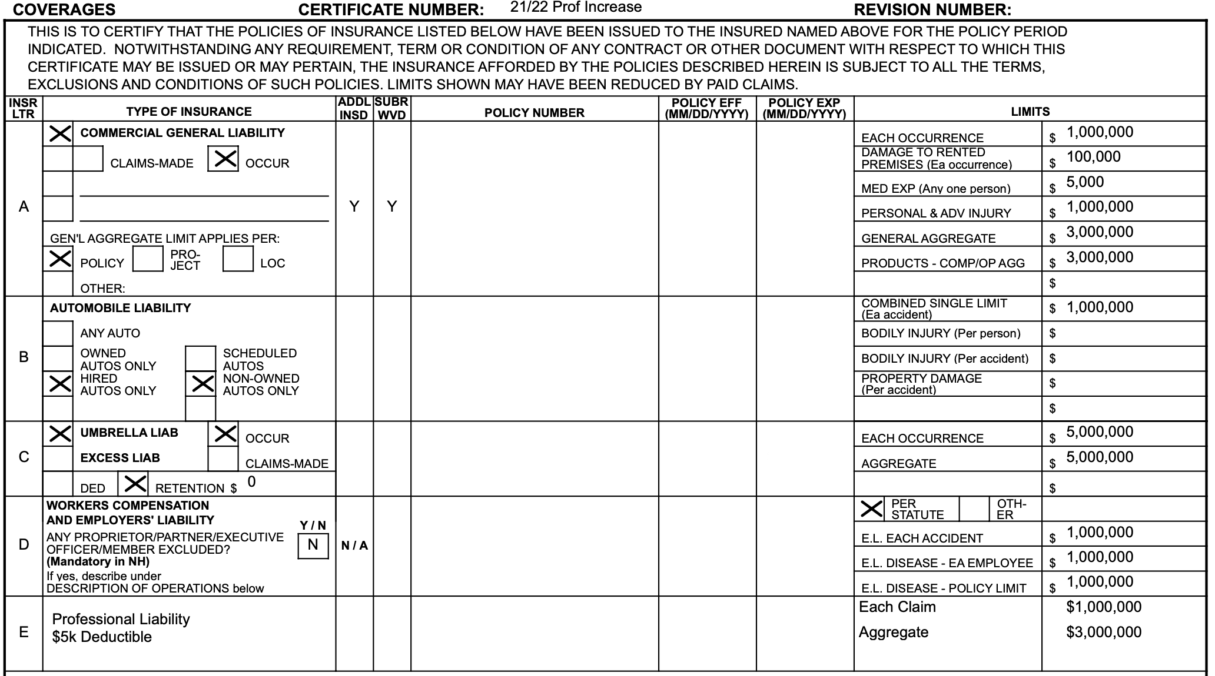
INSURANCE COVERAGE
Client understands and agrees that Greeby carries only the following insurance. Certificates of Insurance for the following insurance coverage will be provided to Client prior to the commencement of administrative consulting services.

Slide 19


AGREEMENT EXECUTION
Date of this agreement shall be:
In witness whereof, the parties hereto have caused this Agreement to be executed on or as of the day and year above written:
Garrett R. Greeby
President & CEO
Name:
Title:
WESTFIELD WORLD TRADE CENTER OCULUS
New York, NY

Slide 20

COMPETITIVE ADVANTAGES
family company that believes in teamwork and hard work to produce successful results
Values
local staff and local knowledge produces cost-effective results across your portfolio
Network
development experts whose expertise in design and construction allow for comprehensive service
Specialists
custom tools that have been tested by industry veterans and supported by in-house experts
Technology

Slide 21


